Slide 1

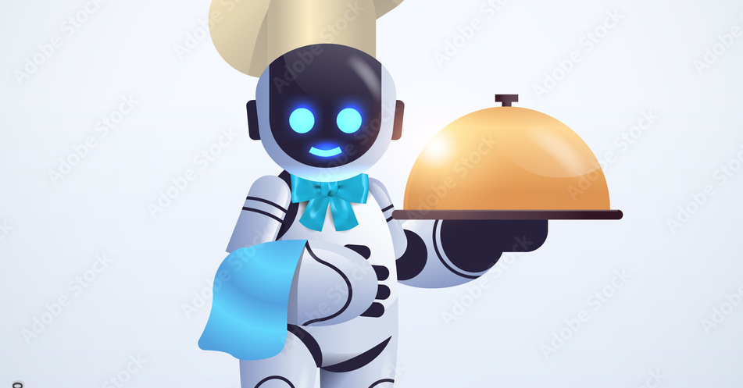

Meal Picker Chatbot
Aiman Haroon Final Project CPSC 46000-003: Programming Languages

Slide 2


Chatbots: -Human like Conversations -Written or Spoken -Simple/Complex User Inquires
Type Of Chatbots:
-Menu/Button Based Chatbots -Rule based Chatbots (Linguistic Based) -Machine Learning Chatbot -Hybrid Chatbot -Voice Bot

Slide 3
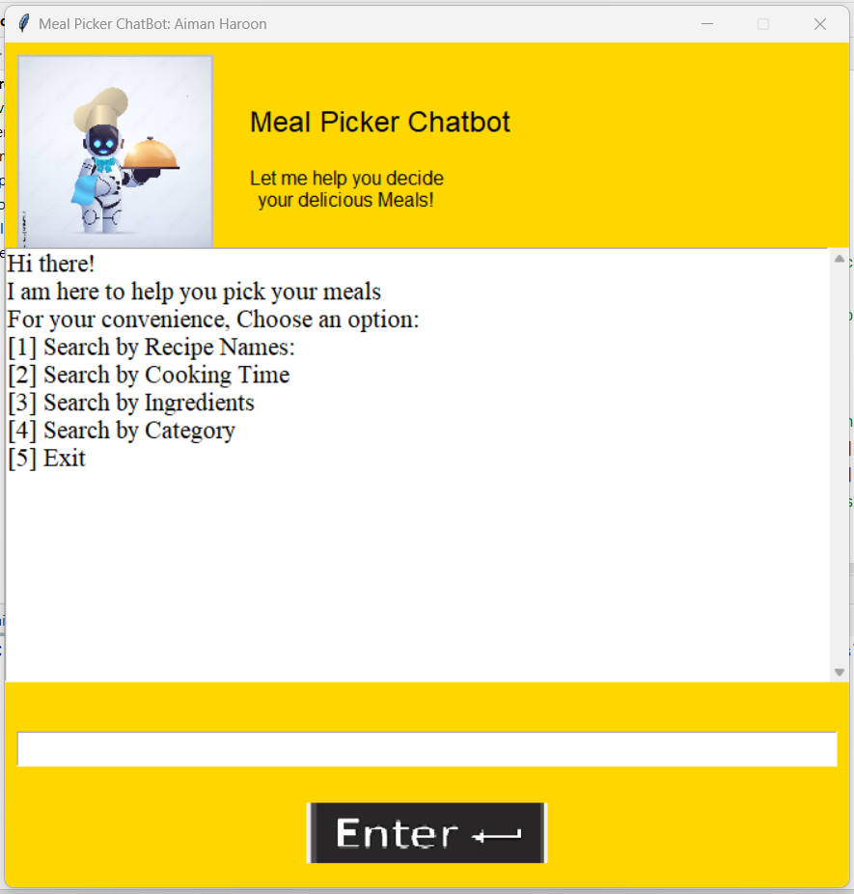
My ChatBot:
Combination of Rule based and Menu Based
If/else conditions
Defined set of Rules/Methods
General Inquiry Method (Linguistic based)

Slide 4
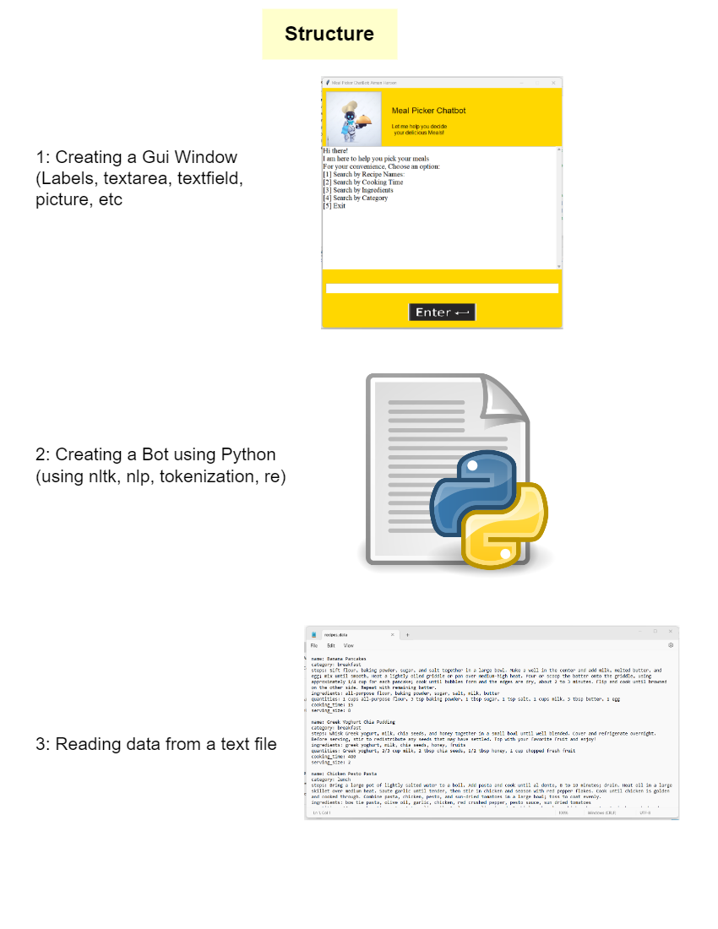

Slide 5

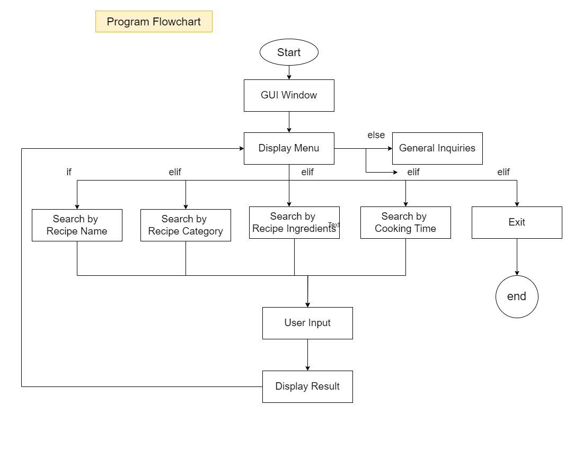

Slide 6
Let’s run the application:

Slide 7
Conclusion: What I learned
Natural Language Processing
Combining Gui and Chatbot
Design and Implementation
User Input Processing

